Slide 1
JIRA PoC IT Steering Committee Backup Materials

Slide 2
Agenda
Enterprise Software Development Tools Alignment
JIRA Background Information
JIRA Implementation Vendor Options

Slide 3
Software Tools and Processes Survey
 | Development Process | SCM | Build | Defect Tracking | Test Tracking | Instant Messaging | Code Reviews
Foundation Pak | Hybrid | Mercurial | Homegrown scripts (automated builds, email notifications) | Bugzilla | TestLink Google Docs | SameTime Skype | Peer+ Review Board
FMC | Agile + Rally | SVN | Homegrown Utilities + Jenkins | Bugzilla 4.2.2 | TestLink Google Docs | Skype | Review Board
Virident Driver | Waterfall | SVN | Homegrown Utilities | Bugzilla 4.2.2 – want JIRA | TestLink | Skype | Review Board
HGST Driver & FW |  | Git (in plan) | Jenkins (in plan) | FogBugz – want JIRA |  |  | Gerrit
HGST G-Tech Tem |  |  |  | JIRA
Cold Storage | Agile | Git | Jenkins | JIRA
Multiple Software Development Teams at HGST Either use JIRA or prefer to use JIRA moving forward

Slide 4
JIRA Background Information
JIRA Overview
JIRA is a proprietary issue tracking product, developed by Atlassian. It provides bug tracking, issue tracking, and project management functions.
Why is JIRA so widely used?
JIRA's flexible plugin architecture spawned a large number of integrations developed by the JIRA development community and third parties, including IDEs like Eclipse and IntelliJ IDEA using the Atlassian IDE Connector. The JIRA API^{[27]} allows developers to integrate third-party applications into JIRA.
According to Atlassian, JIRA is used for issue tracking and project management by over 25,000 customers in 122 countries around the globe.
All HGST software development teams agreed aligning to an enterprise JIRA deployment supported by ISnT would be beneficial to projects new and old.
License Pricing (as reference for production deployment)
Number of Users | Enterprise License Yearly Cost*
500 | $12000
2000 | $16000
*Installation costs and support costs will be extra; will get estimates of all production costs during PoC

Slide 5
JIRA: On-Demand vs. Hosted
While many of ISnT’s new products are on-demand (Box, Jive, O365), the current implementation of JIRA On-Demand has many limitations, including
Not all add-ons and connectors to other systems are supported in the On-Demand version
IP Whitelisting (restricting access by source IP range) is currently not possible
Direct access to the database — Not allowed
Port restrictions for external application links — application links to an external application, the external application must use either an HTTP protocol (on port 80) or HTTPS protocol (on port 443)
JIRA On-Demand System Admin privileges are restricted, including
Importing data from non-Atlassian products into On-Demand requires use of a hosted implementation
Configuring LDAP integration
Modifying SysAdmin users & attributes
Deactivating and renaming users
Based Upon HGST Experience, Product Capabilities and Guidance From Atlassian Expert Partners Will Use Hosted Version of JIRA

Slide 6
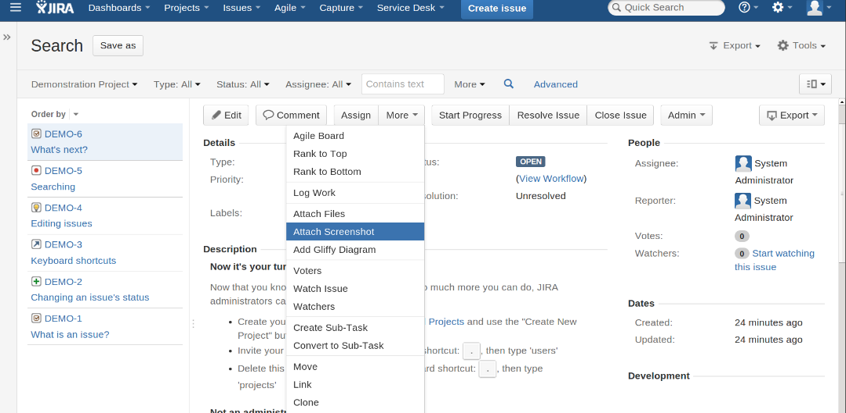
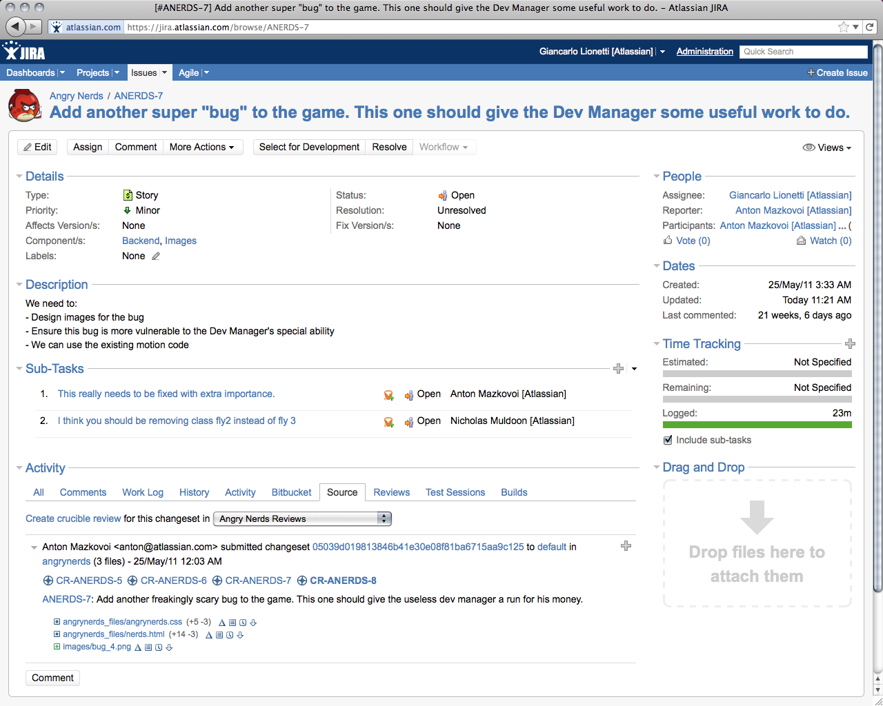
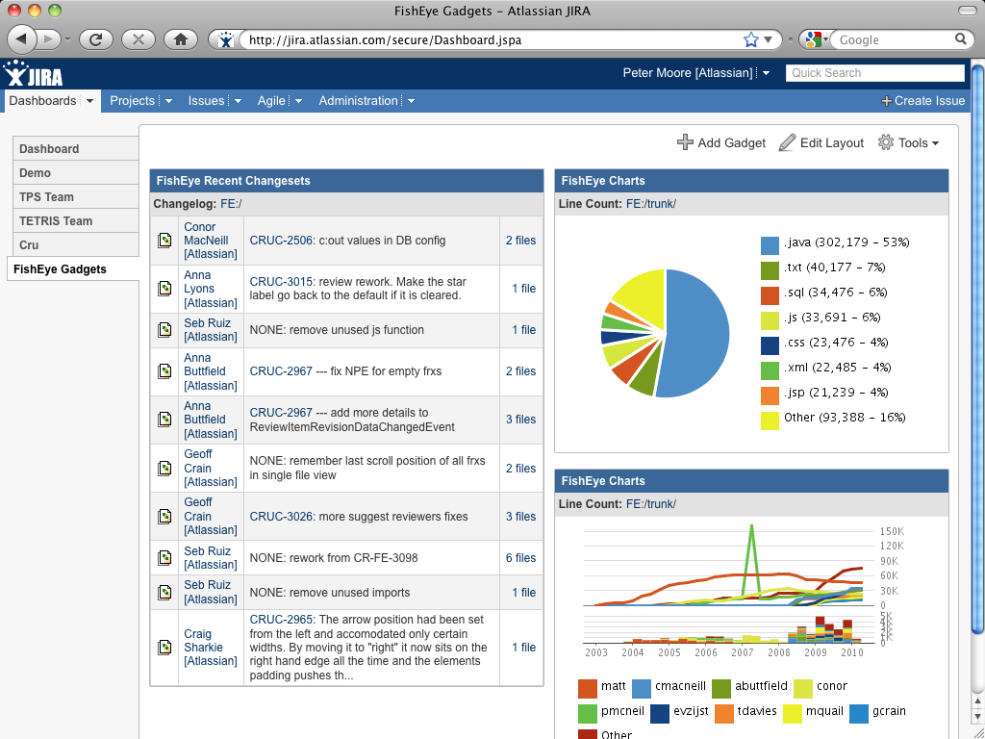
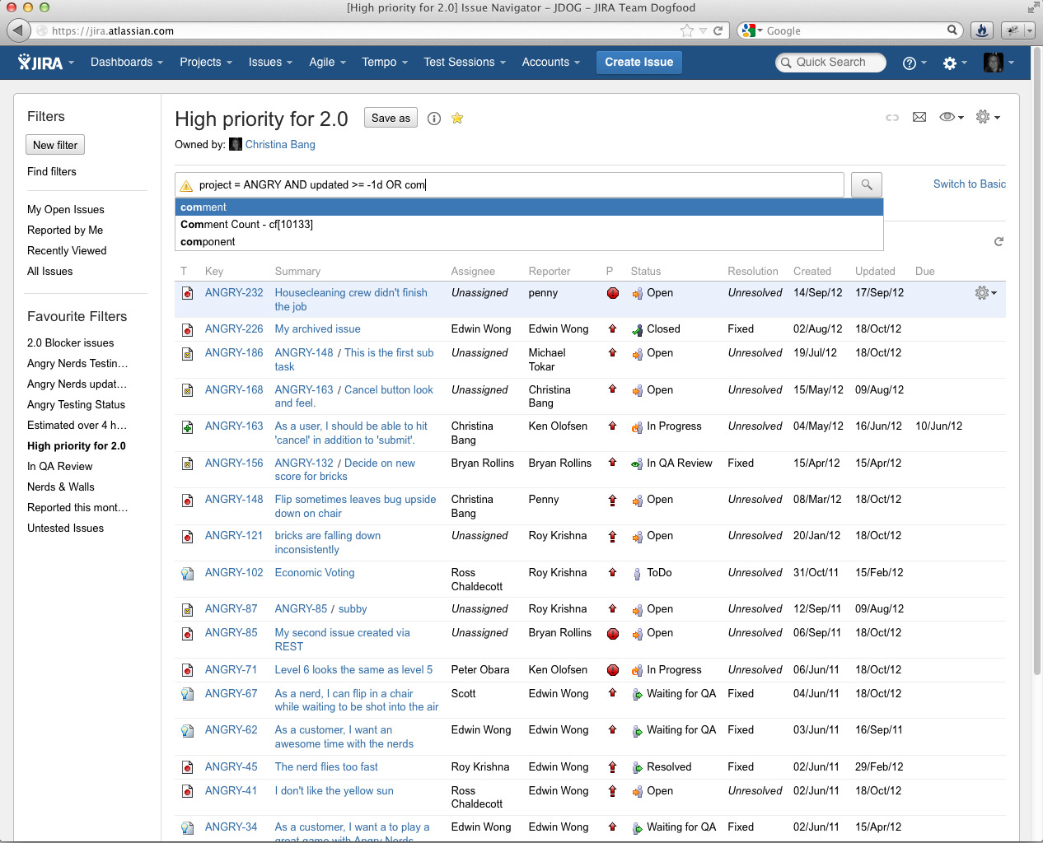
JIRA Screen Shots
A Variety of Views and Details for Filing Bugs / Defects
Very Useful Dashboards and Reporting Capabilities

Slide 7
JIRA PoC Implementation
Atlassian, the JIRA vendor, only provides the software products, basic user and admin training and on-line support through forums
Complex and Enterprise grade implementation and professional services are provided by recommended third party partners
Evaluating two third party partners for PoC
Vendors: App Fusion Coyote Creek
Both third party partners highlighted extensive experience with JIRA hosted deployments for large enterprises
Both have teams based in Bay Area

